Slide 1
Wireless Workstation Revolution
Green Bay Area Public School District
Steve Vande Walle slvandewalle@gbaps.org

Slide 2
About Me
6 Years IT Experience
PC Technician 2, Project Specialist
PC Technician 1
Help Desk
Hardware Team

Slide 3
Green Bay Area Public Schools
22,000 students
43 Buildings
IT department
4 Teams
41 people
CTIO
Director of Technology
Network Engineers
Building Technicians
Hardware Technicians
Programmers
Admin Student Information Systems
Safe Delivery of Students
Help Desk & Tech Acquisition
Central registration
Data quality / Reporting specialist
Identity and Account management
Executive Assistant
Tech Integrators
District Media/AV Coordinator

Slide 4
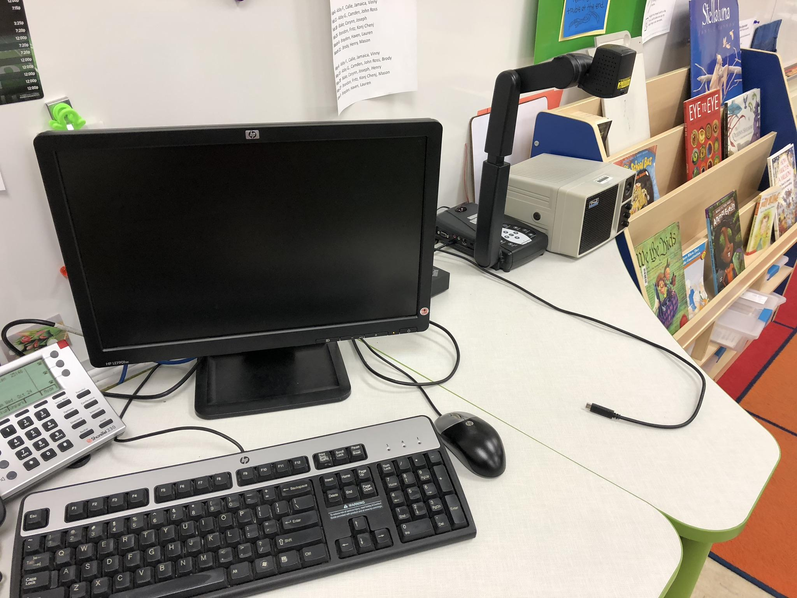
The Wireless Workstation
Same workstation experience follows staff and guest teachers
Laptop
Dock
Ability to project wirelessly
Miracast / Windows Connect

Slide 5
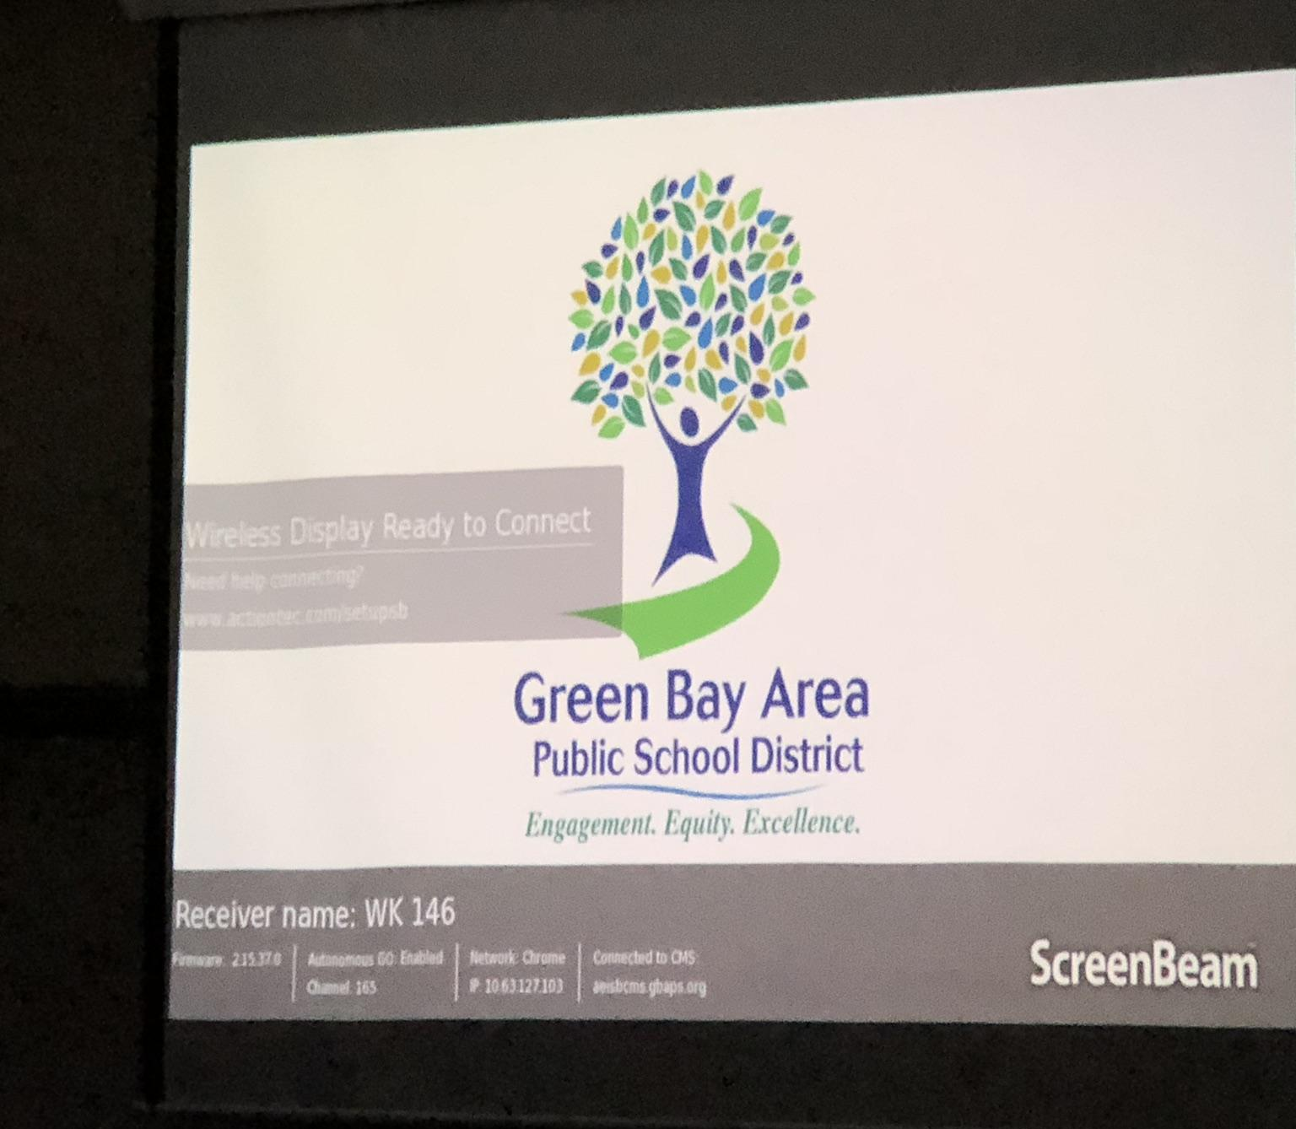
Miracast
WiFi Direct
Capable of sending video and audio to a display
Can send input back in some cases
This doesn’t give you two desktops to use at the same time

Slide 6
Where it started
Fall 2017

Slide 7
Need to replace desktops
Staff
The average desktop in a classroom
HP 6200 / 6000 (6-8 years old)
All classrooms have:
Projector
Document camera
Speaker
Desktop Computer (connected to the projector)
Some Teachers have laptops
Mix - Windows, Chromebooks, and Mac
All Admins have Laptops
Macs
Students
Have Chromebooks
1:1 in some form 3-12
iPads, Macs, Windows Labs

Slide 8
Stakeholder Meeting
Question: Do we just buy more desktops?
Who
Technology Department
Teaching and Learning
Procurement Director
Library Media Specialists (covering K-12)
Why are we redesigning teaching stations?
We want our learning spaces to
Be more flexible
Shift the value of the educator
Teacher guide on the side
Questions:
How will teachers use their teaching stations?
What will teaching stations look like?
Other issues
Subs
Outside organizations
Do we replace the projector?
Access to resources
Staff competency

Slide 9
Vendor Presentations
To the stakeholder group
What is the classroom of the future?
Lead by
Dell, HP, Lenovo, Apple, and Acer

Slide 10
Options
Each option was tested in a classroom
Present desktop with Wireless Keyboard
Present desktop with 13” Chromebook
13” Windows laptop (non-touch) with docking station
12” Windows touch with dock
13” Windows touch with Miracast
Surface Style Windows 10

Slide 11
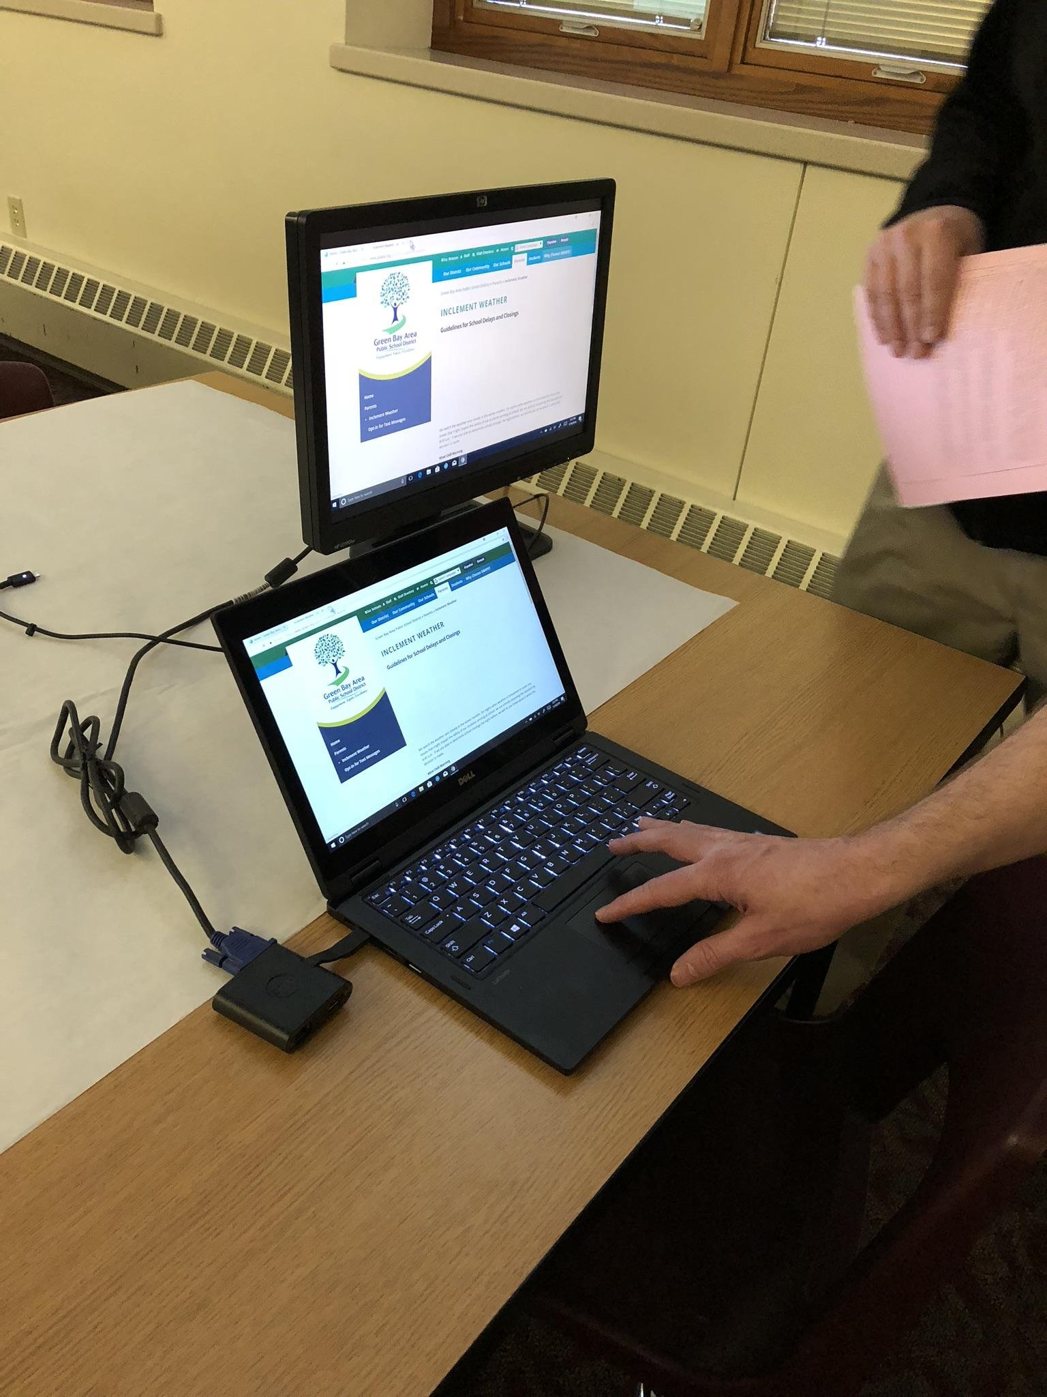
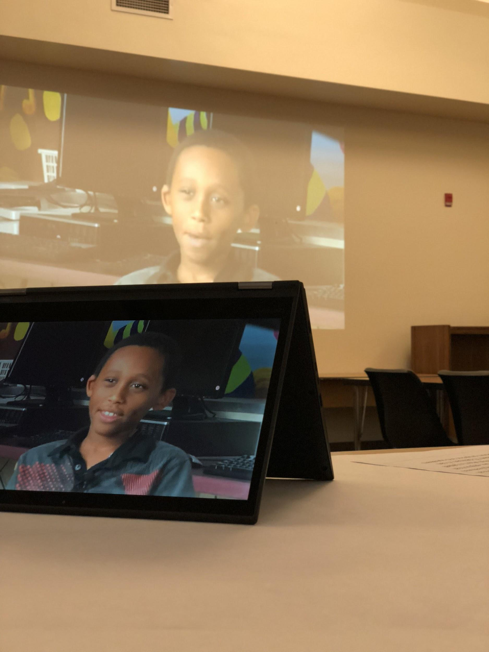
Wireless Workstation Roadshow
The six options go on the road
Four stops after school in different geographic locations
One stop on a work day located in the centrally in the District Office
Sent a digital survey to all staff with videos about each option and asked for feedback
Free form long answer questions
True/False questions

Slide 12
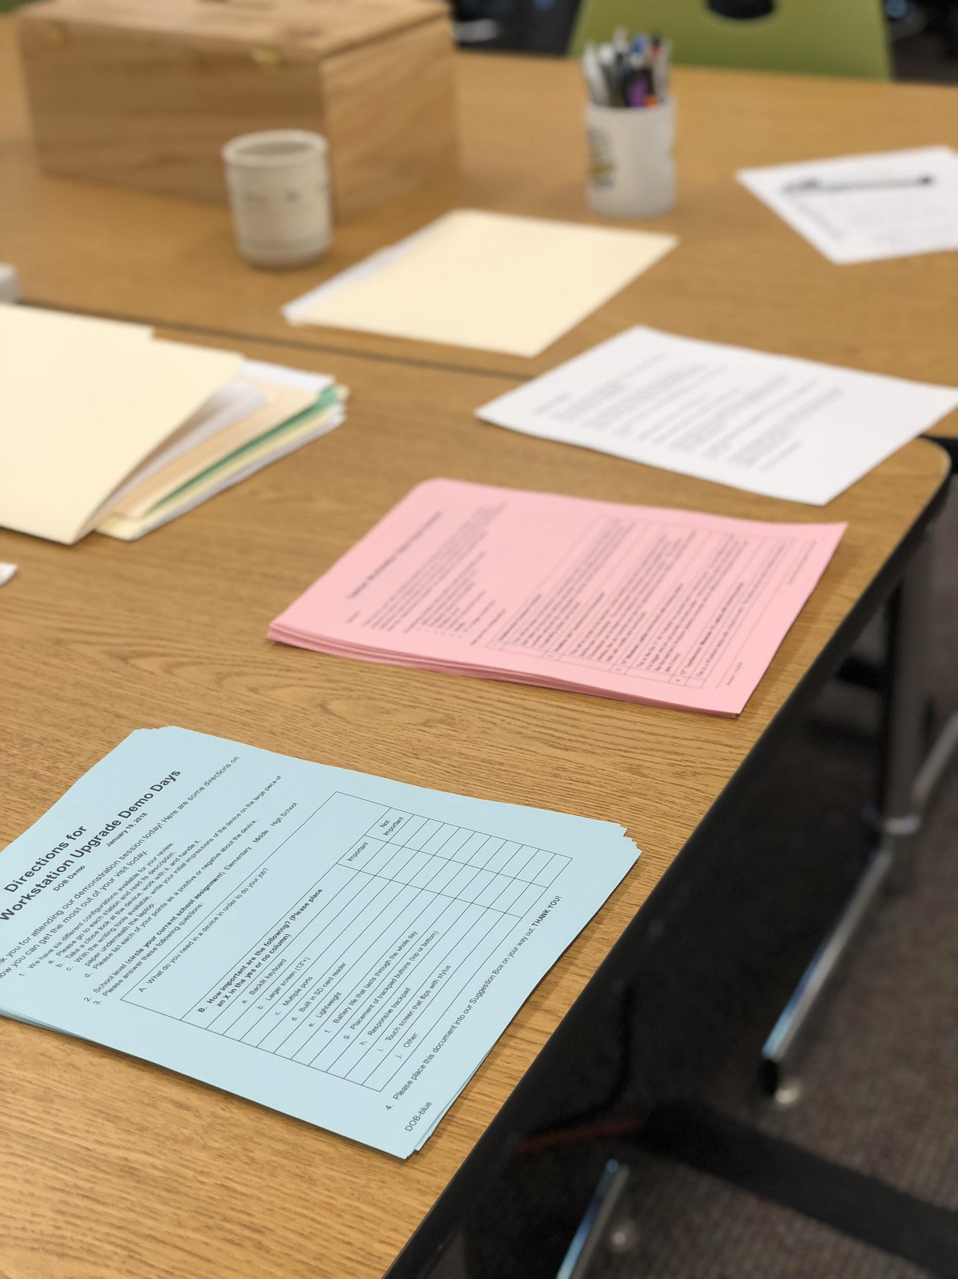
Feedback from 400 Staff
Need to use projector
Want to be mobile
Touch screen
Windows
Larger screen
Attached keyboard
Sturdy

Slide 13
What we were looking for
Laptop
13 inch touch screen with active stylus
Windows Ink
Hardware specific feature of Windows 10
World facing camera
NVMe SSD
Dock
USB C connection to laptop
Support three displays
Powers laptop
Miracast
Screen sharing / Windows Connect
Wifi Direct protocol
Central management
Renaming
Reconfiguring
Firmware Updates

Slide 14
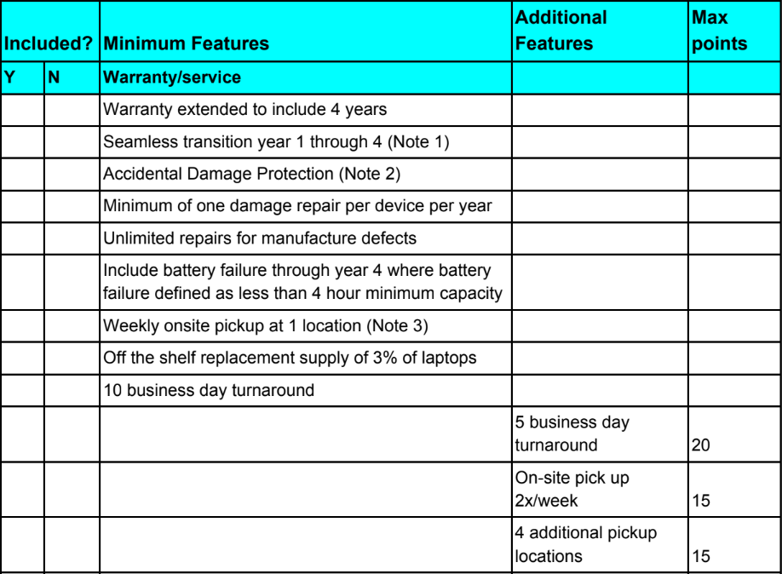
Finding The Right Product
RFI - Service
What service was expected
What service they would score points for
Device specifications we would expect to see in the RFP
RFP - Devices
Issued to vendors after the RFI
Evaluate on device competencies and cost

Slide 15
Winning Combination
Lenovo Thinkpad L380
USB C Dock
ActionTec Screenbeam 750 Wireless Display (Miracast) Adapter

Slide 16
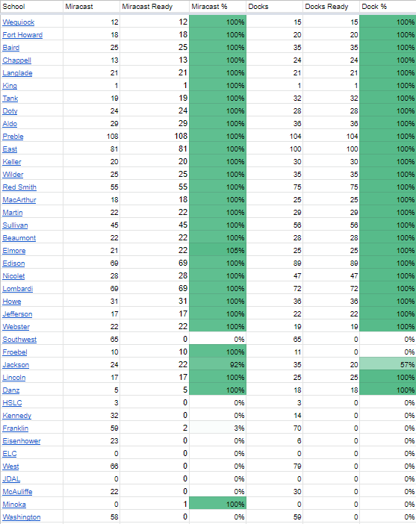
Deployment
Laptops to staff in one hour trainings over the summer and at the start of the year
Docks and Miracast deployed to classrooms building by building

Slide 17
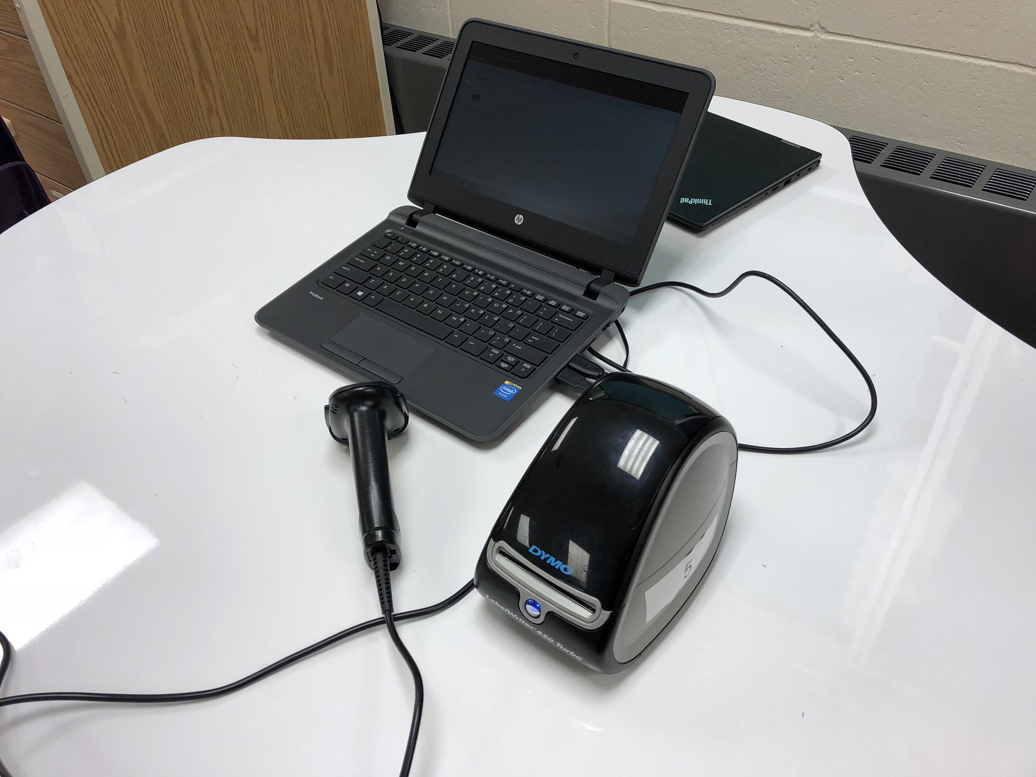
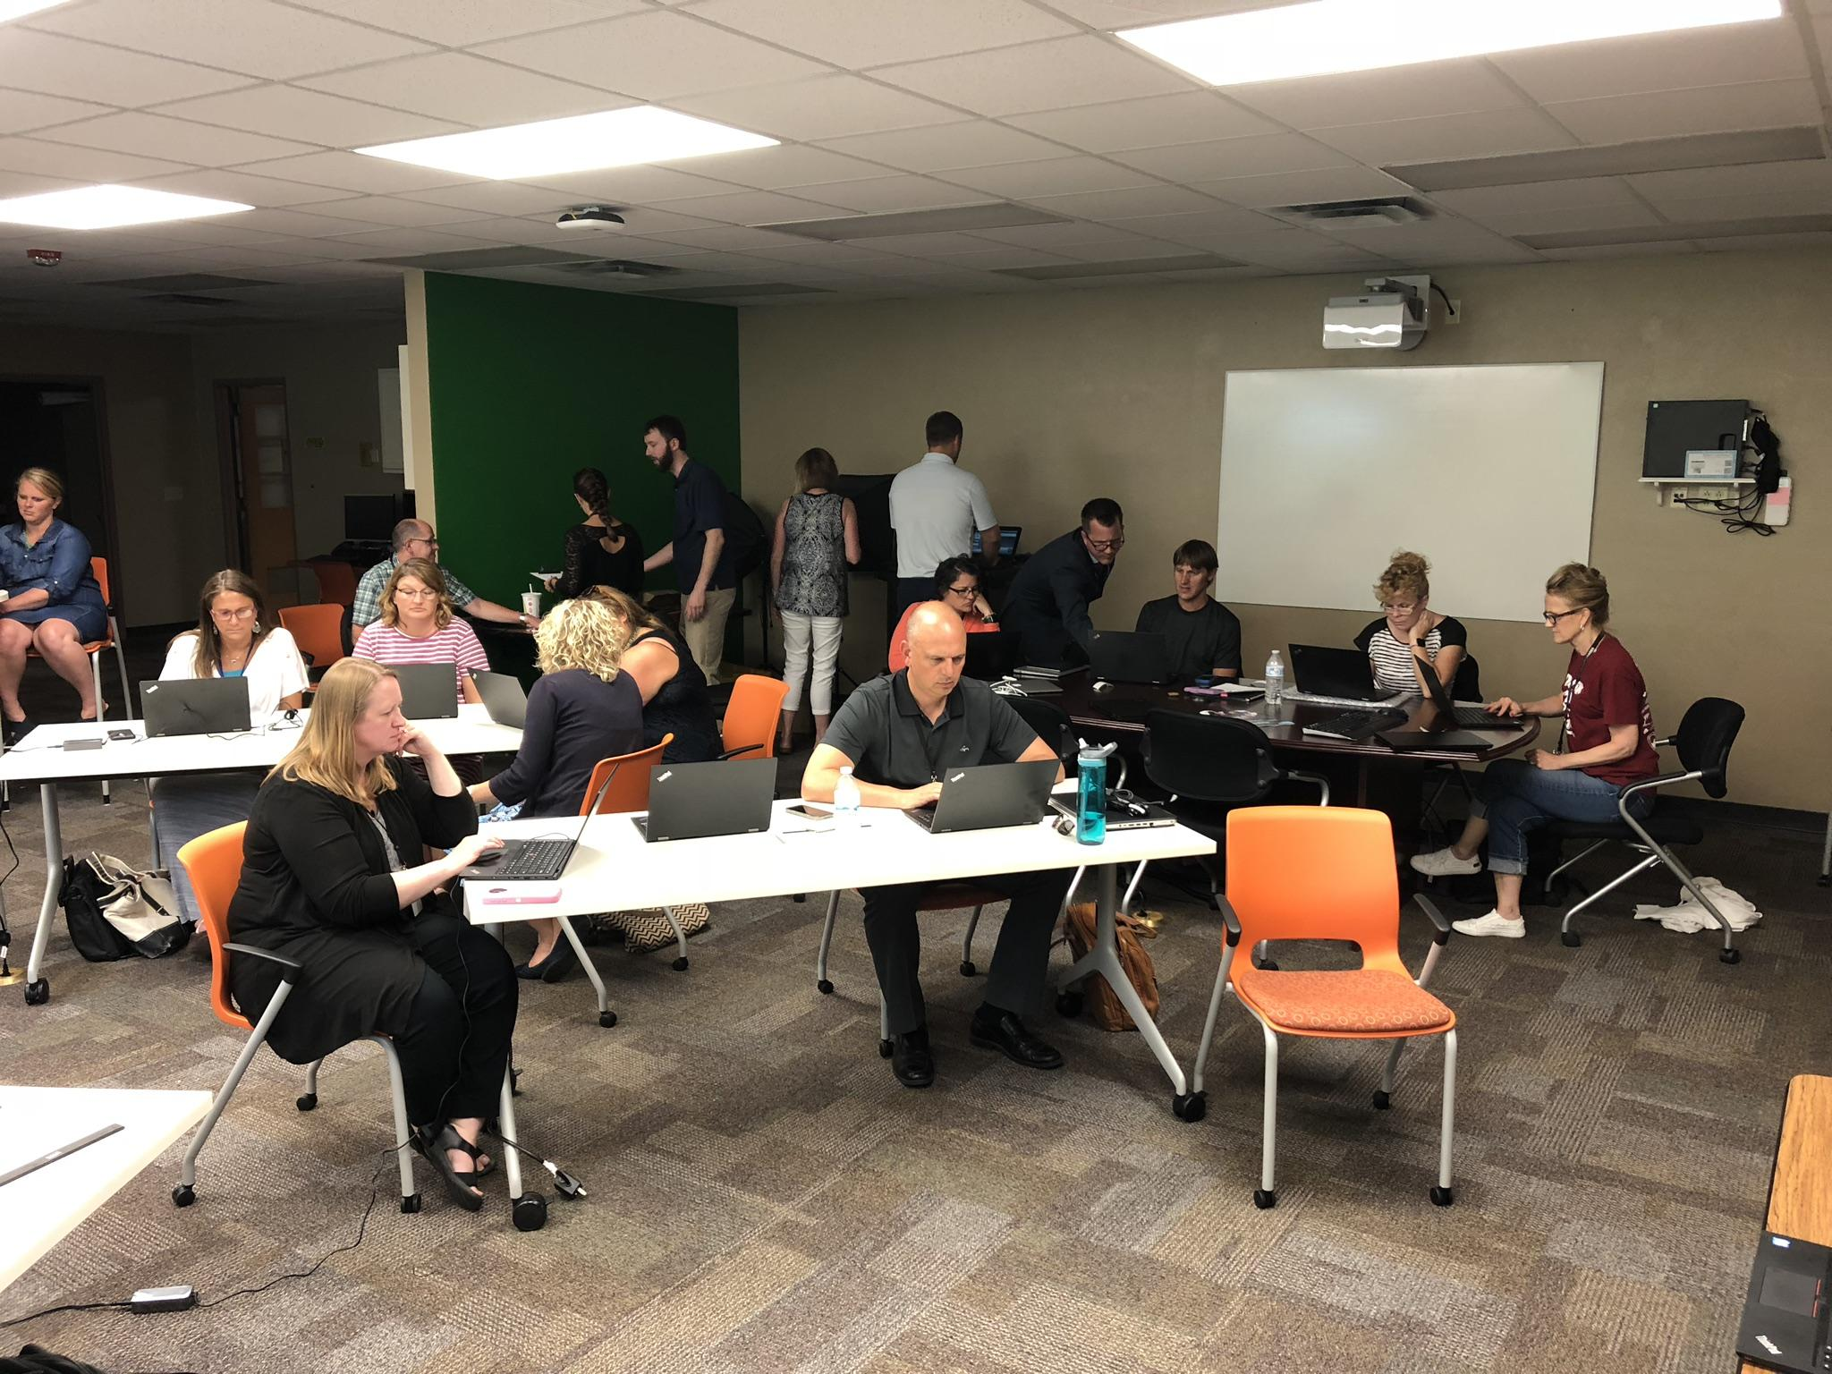
Training Staff
Required online training
In person training and device handout
Weekly short digital lessons
In person learning at their school leading up to and following transition

Slide 18
Updating Classrooms
Challenges
Different projector models
Convert document cameras to be digital
VGA passthrough
Building by building
Week 1 - Update Document Camera
Week 2 - Additional training
Week 3 - Update to Dock and Miracast

Slide 19
Overall Challenges
Timeline
Receipt of the laptops did not allow for spring deployment
Miracast
ScreenBeams only uses non-DFS channels only
ActionTec CMS (management software) works well but needs some polishing
Sound
Docks
VGA Monitors do not always connect
Dock Firmware updates
Laptops
Guest Teachers and After School Program

Slide 20
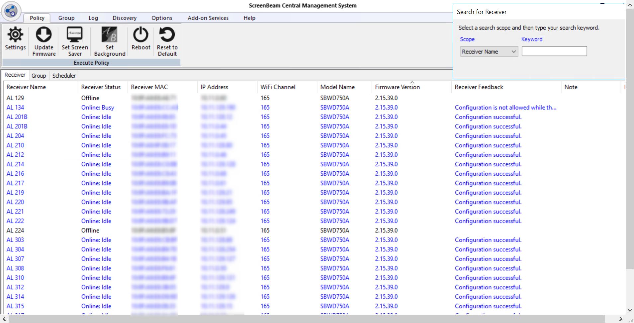

Slide 21
Questions?

